Slide 1
MVC and Java Spring Framework
Week-05
Fall - 2025
Subject: Software Construction & Development
Instructor: Mr. Sharif Hussain

Slide 2
Contents
Model-view-controller MVC
Features Of MVC
Components of MVC
MVC Architecture Diagram
Java Spring Framework

Slide 3
MVC (Model-View-Controller)
The MVC (Model-View-Controller) is a software architectural pattern that divides an application into three components: Model, View, and Controller. Each component performs a specific role, making it ideal for web, desktop, and mobile applications.

Slide 4
Features of MVC
Separation of Concerns ➔ Divides app into Model, View, and Controller.
Reusability ➔ Components can be reused easily.
Maintainability ➔Code is simple to update and debug.
Scalability ➔Easy to expand and modify the application.
Parallel Development ➔Developers can work on different parts simultaneously.

Slide 5
Components of MVC
Model represents the data and business logic of the application.
It manages data, rules, and operations.
Updates the View whenever the data changes.
Examples: Database handling, business rules, and data validation.

Slide 6
Components of MVC (Cont.)
View is the user interface of the application.
Displays data provided by the Model.
Sends user actions (like clicks or input) to the Controller.
Examples: Web pages, forms, dashboards, or UI elements.

Slide 7
Components of MVC (Cont.)
Controller acts as a bridge between the Model and the View.
Handles user input and interprets it.
Updates the Model or changes the View based on user actions.
Examples: Input handling logic, routing, or event control.

Slide 8
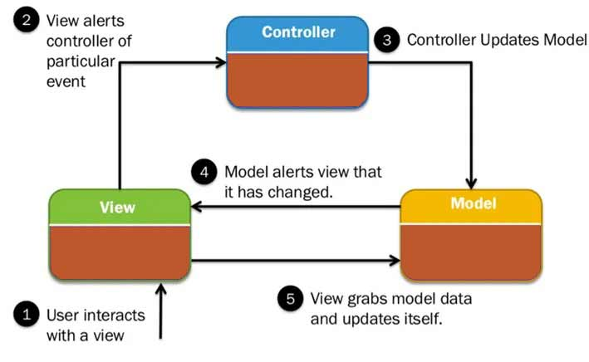
MVC Architecture Diagram

Slide 9
Java Spring Framework
A framework is a predefined software structure that provides ready-made tools and libraries to help developers build applications efficiently. It defines a standard way to organize and write code, making development more consistent, scalable, and easy to maintain.
Example: Django (Python), Laravel (PHP), Angular (JavaScript), and Spring (Java).

Slide 10
Java Spring Framework (Cont.)
The Spring Framework is a powerful and popular open-source framework for Java application development.
It is designed to simplify the creation of enterprise-level applications

Slide 11
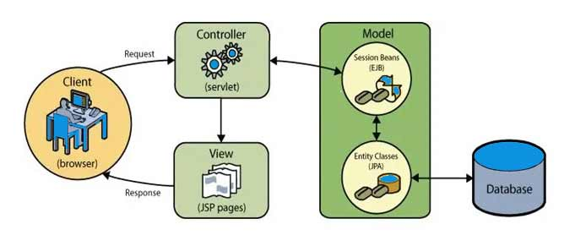
Java Spring Framework (Cont.)
MVC in Java Enterprise Application Development:

Slide 12
Key Features of Spring Framework
Dependency Injection (DI): Automatically manages object dependencies.
Inversion of Control (IoC): The framework controls object creation and management.
Modularity: Developers can use only the needed components (Spring Core, Spring MVC, Spring Boot, etc.).
Spring MVC: Provides a structured way to build web applications using the Model-View-Controller pattern.
Integration: Works well with databases, web services, and other Java technologies.

Slide 13
Thanks
...?

